Slide 1
Statistical Analysis
Types of Errors

Slide 2
Types of mistakes
 | Null Hypothesis
 | TRUE | FALSE
Do not reject | OK | Mistake: Type 2
Reject | Mistake: Type I | OK
Type I error is the significance level α which we set ourselves
Probability of rejecting the null hypothesis when it is true
Now we will examine the Type 2 error
Probability of not rejecting the null hypothesis when it is false

Slide 3
Type 2 error
Probability of not rejecting H₀ when it is false
Look at the opposite
Probability of rejecting it when it is false
This is called power ( 1- Type 2 error)
You can calculate it for lots of different values of H₁

Slide 4
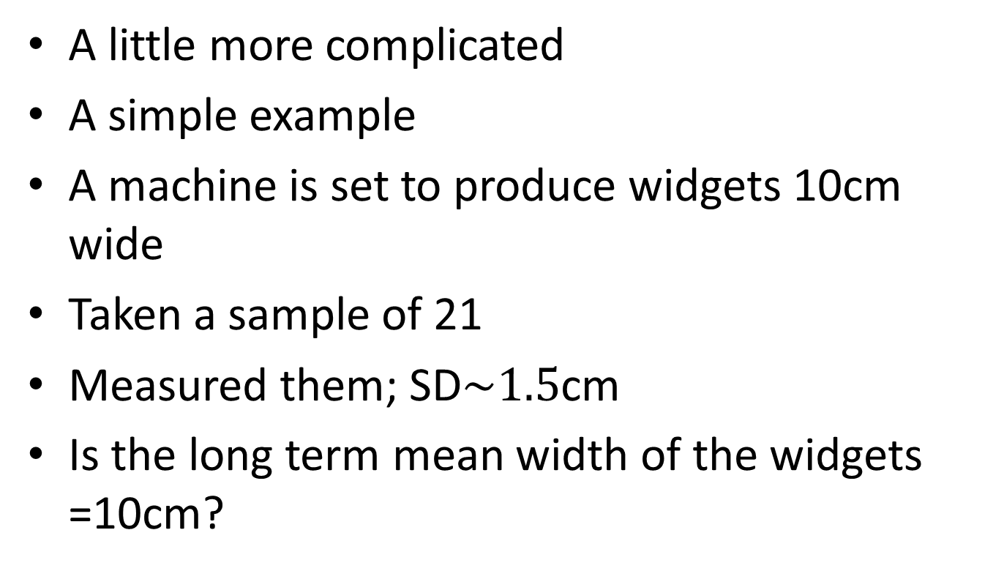
Type 2 error
A little more complicated
A simple example
A machine is set to produce widgets 10cm wide
Taken a sample of 21
Measured them; SD$\sim 1.5$cm
Is the long term mean width of the widgets =10cm?

Slide 5
And more…
H₀: Long term mean =10 cm
H₁: Long term mean ≠ 10 cm
Set α = 0.05 – Type 1 error
Type 2 error – probability of accepting H₀: when it is false
We have to look at particular values of the long term when H₀ is false

Slide 6
And again …
We choose a value of 11 cm
Suppose the long term value was 11 cm what would you expect to happen when you took samples of size 21.
We would still get different values for our sample means.
Assume that the SD is 1.5cm for this situation as well.
Look at the sampling distributions of the means under this value
We look at the overlap of the sampling distributions under the H₀ and this particular H₁

Slide 7
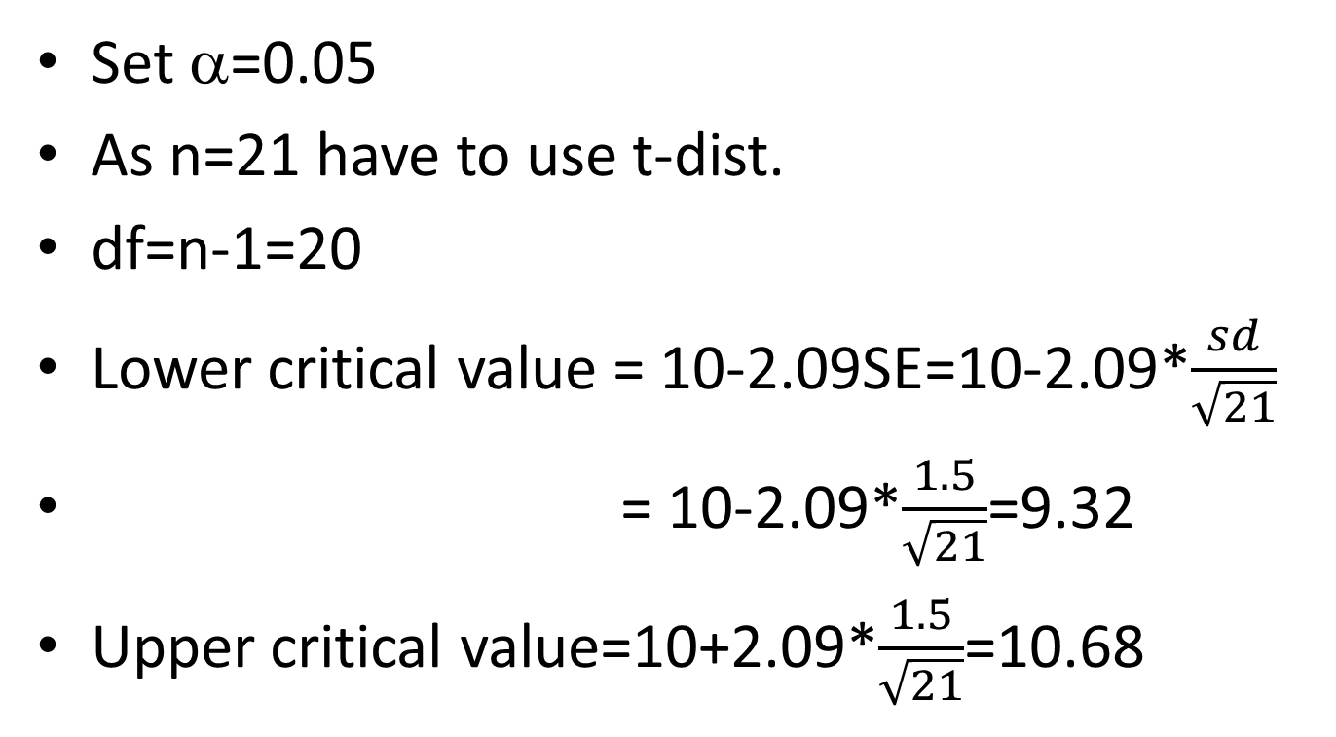
Critical values
Set α=0.05
As n=21 have to use t-dist.
df=n-1=20
Lower critical value = 10-2.09SE=10-2.09*$\frac{sd}{\sqrt{21}}$
= 10-2.09*$\frac{1.5}{\sqrt{21}}$=9.32
Upper critical value=10+2.09*$\frac{1.5}{\sqrt{21}}$=10.68

Slide 8
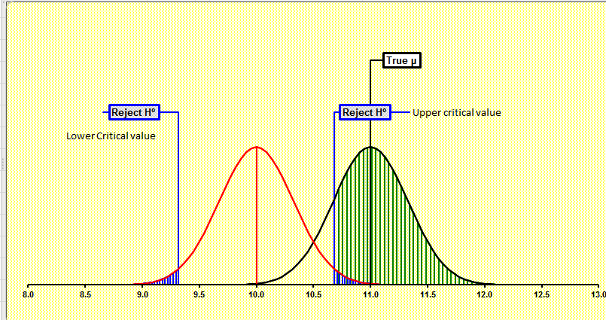
A pretty picture

Slide 9
And more…
Any sample values between 9.32 and 10.68 offer no evidence against H_{0.}
We can see the two sampling distributions overlap
The big question is how much?
What proportion of the 11-curve lies to the right of 10.68
This is the power of the test

Slide 10
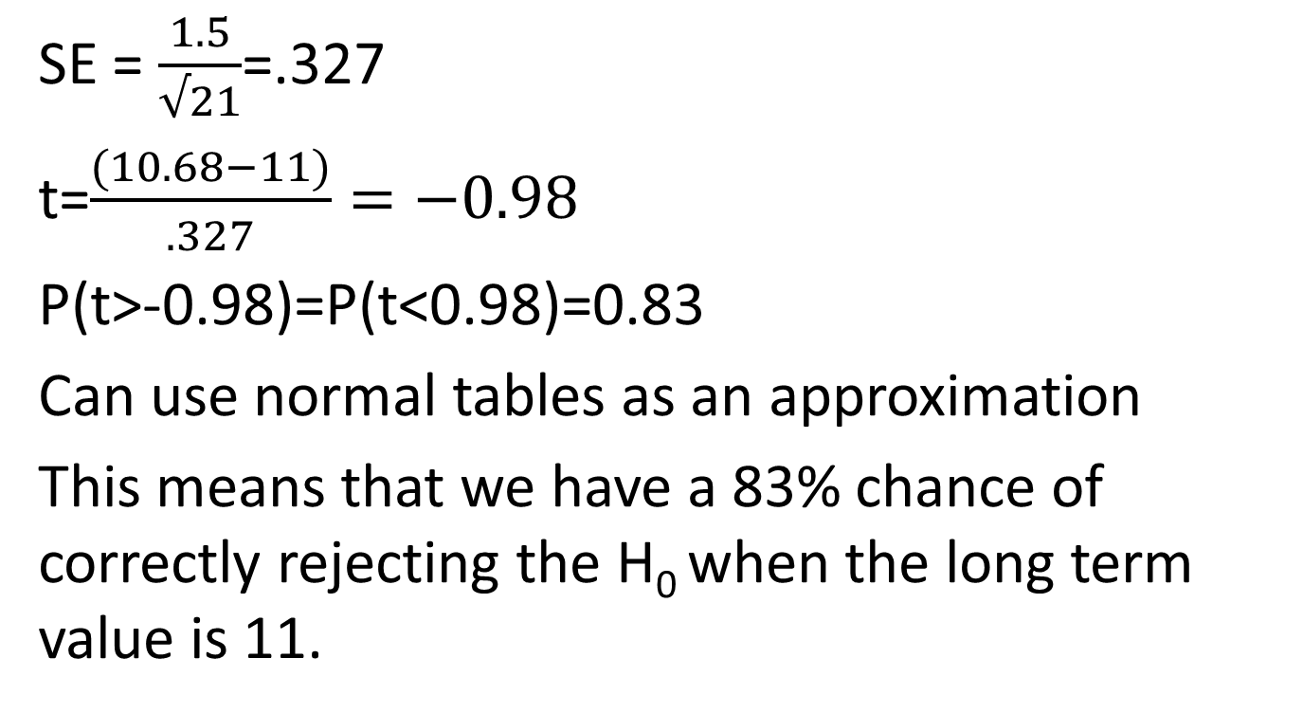
Some calculations
SE = $\frac{1.5}{√21}$=.327
t=$\frac{(10.68−11)}{.327}=−0.98$
P(t>-0.98)=P(t<0.98)=0.83
Can use normal tables as an approximation
This means that we have a 83% chance of correctly rejecting the H₀ when the long term value is 11.

Slide 11
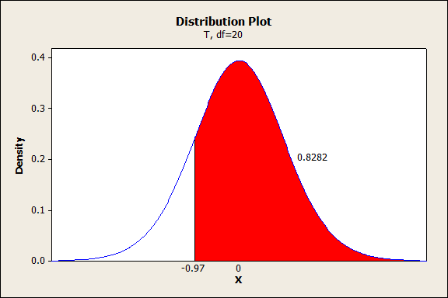
Pretty picture

Slide 12
How do we increase this chance?
We can change the value of SD
We can change the value of n
Then what happens
The key is to understand the concept of power
This can be applied in many situations
You have to calculate it for many values of the alternative hypothesis
What is an important value?

